Slide 1
IBM CAPSTONE PROJECT – The Battle of Neighborhoods: Cluster Analysis of The City Of Melbourne To Determine The Best Suburb for a Start-up Restaurant August 2019

Slide 2
1.0 BACKGROUND
Akatamba Limited is a Nigeria-based IT consulting firm focusing on providing specialized and customized services to assist investor who intends to set-up business outfit in major cities of the World. Due to market competition, Akatamba decided to adopt data science techniques to offer a brand-new recommendation system for its clients.

Slide 3
1.1 INTRODUCTION
Melbourne, the world's most livable city according to The Economist Intelligence Unit is the coastal capital and most populous city of the southeastern Australian state of Victoria and the second most populous city in Australia and Oceania. It has a population of about 5 million (19% of the population of Australia), and its inhabitants are referred to as "Melburnians". At the city's center is the modern Federation Square development, with plazas, bars, and restaurants by the Yarra River.
The city was founded on 30 August 1835, in the then-British colony of New South Wales by free settlers from the colony of Van Diemen’s Land (modern-day Tasmania).
Melbourne is an international cultural center and the city serves as Australia's cultural capital, with prominent offerings in the form of major events and festivals, drama, musicals, comedy, music, art, architecture, literature, film and television. The climate, waterfront location and nightlife make it one of the most vibrant destinations in Australia. For seven years in a row (from 2011 to 2017) it held the top position in a survey conducted by The Economist Intelligence Unit as the world most livable city.

Slide 4
INTRODUCTION Continues…….
Melbourne has long been regarded as Australia's sporting capital due to the role it has played in the development of Australian sport, the range and quality of its sporting events and venues, and its high rates of spectatorship and participation. Melbourne’s sporting reputation was recognized in 2016 when, after being ranked as the world's top sports city three times biennially, the Ultimate Sports City Awards in Switzerland named it 'Sports City of the Decade.
Melbourne has the 10th largest immigrant population among world metropolitan areas and with its diverse culture, comes diverse food items. There are many restaurants in Melbourne, each belonging to different categories like Chinese, Indian, French etc. Therefore, in this project we will list and visualize all major parts of Melbourne that has great restaurants.
.

Slide 5
Business Problem section
Problem Statement: To Identify using Data Science Tools , the Prospects of Start-Up Restaurant in Suburbs of Melbourne, Victoria, Australia.
An investor is planning to build a Start-Up Restaurant in Melbourne that will always play an essential role in the business, social, intellectual and artistic life of a thriving and ever-bubbling Melbourne society.
The investor is particularly interested in locations of Melbourne and we will therefore focus on the areas with less or no Restaurants. We are focusing on areas with no Restaurants or having less than 2 Restaurants within 1 km and close to city center as possible-The less competitive suburbs.
We will use data analysis and clustering algorithm to generate the most optimal neighborhoods based on these criteria and suggest 5 neighborhoods to the investor.

Slide 6
Data Preparation
Scrapping Melbourne suburbs Table from Wikipedia
Requests and Beautifulsoup was used to scrap and wrangle the List of Melbourne suburbs from
https://en.wikipedia.org/wiki/List_of_Melbourne_suburbs
https://www.urban.com.au/news/census-2016-the-20-most-densely-populated-areas-of-melbourne and financial scenario?
CSV file containing the list of suburb coordinates
We used Foursquare information on venue categories, top tips, location data, ratings.

Slide 7
Solution
Clustering the city of Melbourne Suburbs in order to recommend appropriate suburb to the investor.

Slide 8
Data and Methodology
Data: merging data of Melbourne and clustering
Mehodology:
Collect Inspection Data;
Explore and Understand Data;
Data preparation and preprocessing;
Modeling

Slide 9
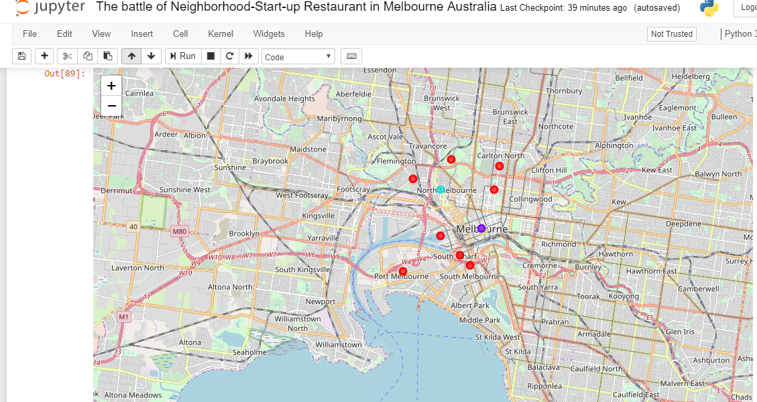
K-Means clustering

Slide 10
Outcome/Reccommendation:
A critical evaluation of the availability and spread of Top 10 most commonly visit Venues In Suburbs of the City of Melbourne, Victoria, Australia.
Melbourne CBD might be considered highly profitable venues to any busniess bacuse of the population and centrality;However ,high cost of rent and housing would constitute as big problems for start-ups
North Melbourne ,Port Melbourne ,West Melbourne and South Yara might not be suitable for Start-ups because of availability of Industrial leaders in restaurant business in these Suburbs.
3. Parkvile is the most suitable Suburb to set up a restaurant business owing to scrace nature of such venues in the Suburb as shown in cluster analysis of Cluster 1

Slide 11
CLOSING
Thank you for listening

